Slide 1

NIKE, Inc. (NKE)
Weighted Average Cost of Capital (WACC) Report (Part 1)

Slide 2



Executive Summary: Final Estimated WACC
Our comprehensive analysis concludes with a final estimated WACC of 10.06% for NIKE, Inc. This figure reflects the company's capital structure and current market conditions.
Detailed Calculation
Market-Value Weights
As of May 31, 2025
Step-by-step methodology for transparency.
Utilizing current market data for accuracy.
Timely and relevant financial snapshot.

Slide 3
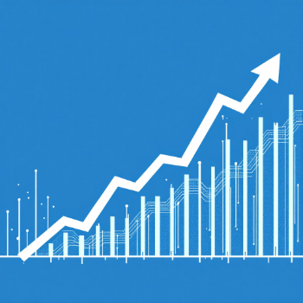

Capital Structure Overview
Nike maintains a conservative capital structure, predominantly financed by common equity with minimal long-term debt. All market values are rounded to the precision shown.
Equity (Market Value)
Debt (Fair Value)
$176.75 billion
$6.673 billion
Preferred Stock: Immaterial (~$0.3 million)
Total Firm Value (E + D + Pref): $183.423 billion

Slide 4

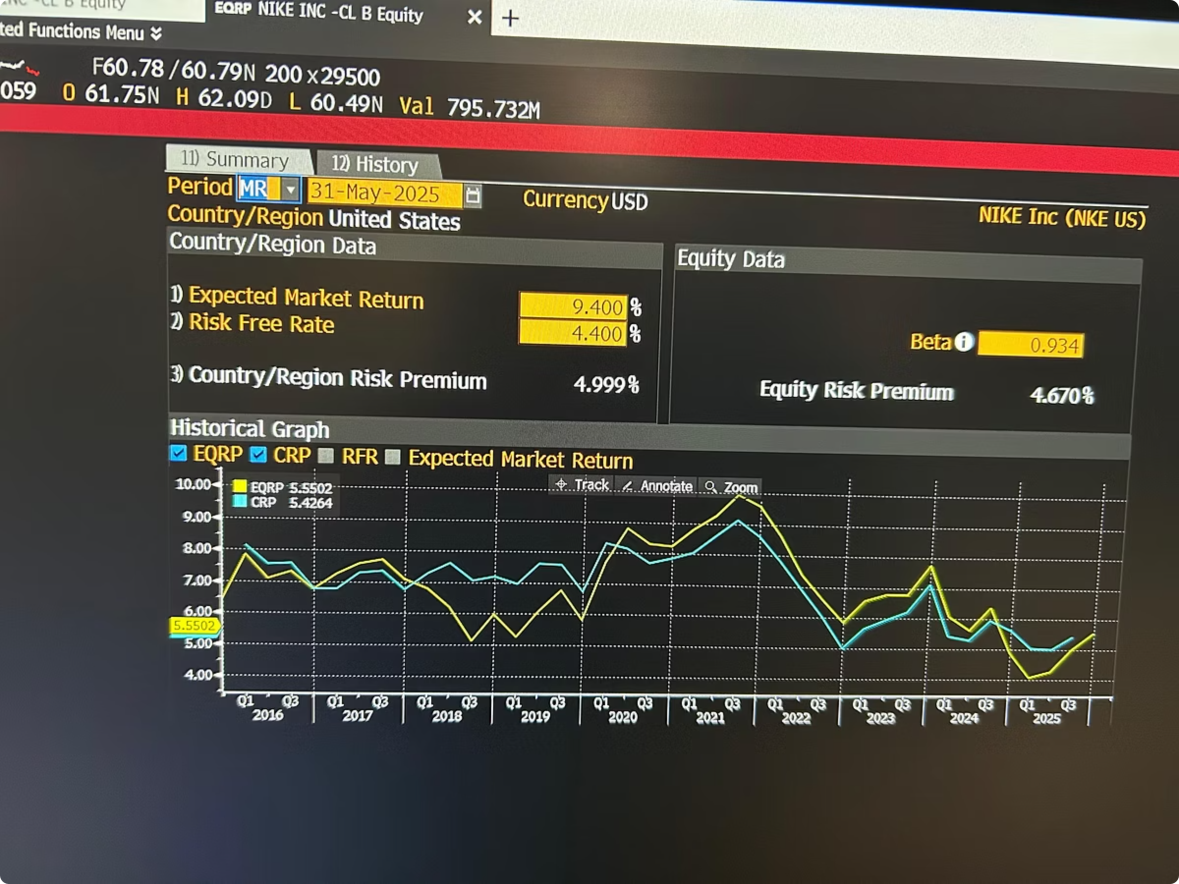
Cost of Equity (Ke) — CAPM
The Cost of Equity is estimated using the Capital Asset Pricing Model (CAPM), suitable for a mature, publicly-listed firm with reliable market data.
1
2
Risk-Free Rate (Rf)
Beta (β)
4.40% (Source: Bloomberg)
1.26 (Source: Mini Case Study 3)
3
Market Risk Premium (MRP)
4.67% (Source: Bloomberg)
Formula: Ke = Rf + β × MRP
Calculation: Ke = 4.40% + 1.26 × 4.67% = 10.28%

Slide 5

Cost of Debt (Kd) — Bond-level Value-weighted YTM
The pre-tax cost of debt is a value-weighted average of each outstanding bond's Yield to Maturity (YTM). The after-tax cost incorporates the company's effective tax rate.

Slide 6
Bond-Level Inputs and Calculations
Maturity Date
CUSIP
Coupon Rate
Amount Outstanding ($ Millions)
Carrying Value ($ Millions)
YTM (%)
Weight (%)
Contribution
03/27/2030
654106AK9
2.850%
1500
1495
4.3869
18.7790
0.8238
03/27/2040
654106AL7
3.250%
1000
993
5.5068
12.4733
0.6869
03/27/2050
654106AM5
3.375%
1500
1483
5.7744
18.6283
1.0757
11/01/2026
654106AF0
2.375%
1000
999
4.2006
12.5487
0.5271
11/01/2045
654106AE3
3.875%
1000
997
5.7776
12.5236
0.7236
03/27/2027
654106AJ2
2.750%
1000
999
4.2224
12.5487
0.5299
11/01/2046
654106AG8
3.375%
500
493
5.8256
6.1927
0.3608
05/01/2043
654106AD5
3.625%
500
502
5.6865
6.3057
0.3586
Total
8000
7961
100
5.086
Totals
Formula (pre-tax weighted YTM):
Weighted Kd_pre = Σ (Carrying Value_i / Total Carrying Value) × YTM_i
Original Principal: $8,000M
Carrying Value: $7,961M
Weighted YTM: 5.0864%
The $39M difference between principal and carrying value reflects amortized discount/premium under U.S. GAAP.

Slide 7

After-Tax Cost of Debt
After-tax Kd formula:
Kd_after_tax = Kd_pre × (1 − Tax Rate)
With an effective tax rate of 17.1% (corrected to 23%) for FY2025, the after-tax cost of debt is calculated as follows:
Kd = 5.0862 × (1 − 0.23) = 3.915

Slide 8
Market Value Calculations
Equity market value is derived from diluted shares outstanding and the closing market price on May 31, 2025.
Shares Outstanding (diluted)
Closing Price (May 31, 2025)
Equity Market Value
1,487.6 million (from 10-K Note)
$118.85
$176.801 billion (from 10-K Note)
Debt fair value (from 10-K Note): $6.673 billion
Preferred stock is immaterial (≈ $0.3 million) and excluded from WACC.
Why Preferred stock is Excluded;
Even if the preferred cost were extremely high or low, multiplying it by a 0.00016% weight would produce a near-zero contribution to WACC (on the order of 0.00000x%).
Nike's financing strategy does not rely on preferred equity, and this tiny amount: Does not influence risk, Does not impact leverage, Does not shape investor expectations
It Is Not Actively Traded or Issued. Held by a single entity (Sojitz Corporation of America), Redeemable, Not part of Nike’s ordinary financing channels, More of a legacy or contractual instrument than a capital-raising tool

Slide 9
WACC Calculation and Breakdown
The WACC is calculated using market-value weights, combining the cost of equity and the after-tax cost of debt.
WACC = (E/V × Ke) + (D/V × Kd × (1 − T))
Component | Market Value ($ million) | Weight
Common Equity | 176,801 | 96.39%
Debt (fair value) | 6,673 | 3.64%
Preferred | ~0 | 0.00%
Total Firm Value | 183,423 | 100%
Weight
Cost
WACC
Equity (E)
96.39%
10.2842%
9.9129%
Debt (D)
3.6370%
3.915%
0.142%
Computed WACC = 10.055%

Slide 10

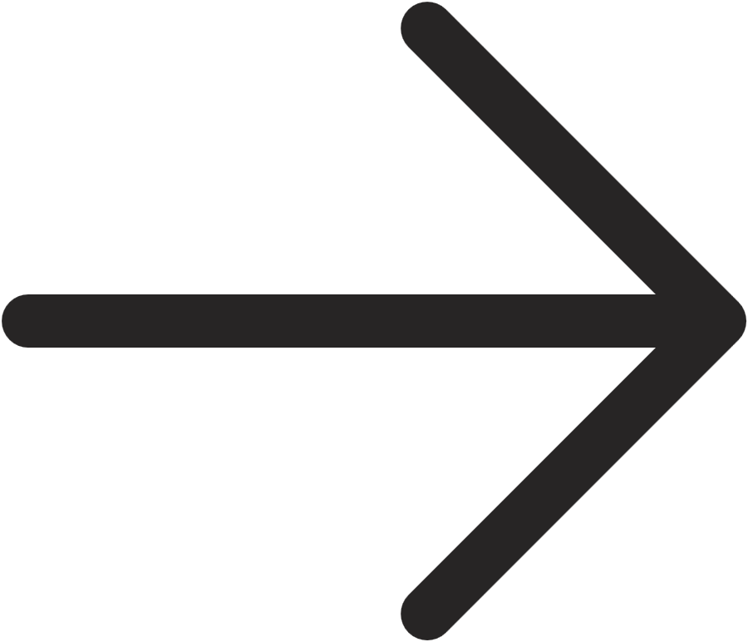
Interpretation and Implications
Nike's WACC of 10.06% is higher than expected for a mature, large-cap consumer company, primarily due to its equity-heavy capital structure.
Low Leverage
Market Conditions
Investment Rule
Limits benefits from interest tax shield; increases relative weight of equity.
Elevated risk-free rates and a high market risk premium increase the cost of equity.
Projects should target a Return on Invested Capital (ROIC) greater than WACC (> 10.06%) to be value-accretive.
Nike is a Strong Brand
Financial Flexibility
Enables pricing resilience; Pricing Power allows Nike to earn returns above the cost of capital even under market pressures such as inflation or supply chain shifts.
Allows Nike to internally fund growth.
Nike can choose when (or if) to issue debt, taking advantage of favorable market conditions.

Slide 11

NIKE, Inc. 5-Year Project Evaluation Report (Part 2)
This report evaluates a proposed 5-year product expansion project for NIKE, Inc., detailing financial projections and key investment metrics.
All financial figures in tables are presented in thousands ($000s).

Slide 12
Project Overview
Initial Capital Spending
Initial NWC
$30,000,000
$2,000,000
Sales Year 1
Sales Growth (SGR)
$35,000,000
7.5% from Mini Case Study 2
Fixed Costs
Salvage Value
$10,000,000 annually
$5,000,000
Tax Rate
Required Return
17.1% From Part 1 (correct to 23% )
WACC 10.05% (from Part 1) + 2% risk premium = 12.05%
The project involves an initial capital expenditure of $30,000,000 and an initial net working capital of $2,000,000. Sales are projected to start at $35,000,000 in Year 1 with a 7.5% growth rate. Fixed costs are $10,000,000 annually, and the equipment has a salvage value of $5,000,000. The combined tax rate is 23%, and the required project return is 12.06%.

Slide 13
MACRS Depreciation Schedule
The project's depreciation is calculated using the 5-year MACRS schedule on a depreciable base of $30,000,000.
Figures in ($,000s)
Year
MACRS
Depreciation
=MACRS rates * Equipment Cost
1
20.00%
6,000
2
32.00%
9,600
3
19.20%
5,760
4
11.52%
3,456
5
11.52%
3,456
Total depreciation over the 5 years is $28,272,000. The book value at the end of Year 5 is $1,728,000 ($30,000,000 - $28,272,000).

Slide 14





After-Tax Salvage Value
The after-tax salvage value is calculated considering the market value, book value, and tax on the gain.
Market Value
Book Value
$5,000,000
$1,728,000
Gain
Tax on Gain
5,000,000 – 1,728,000 = $3,272,000
3,272,000 × 0.23 = $752,560
The after-tax salvage value is 5,000,000 – 752,560 = $4,247,440 , which is derived by subtracting the tax on the gain from the market value.

Slide 15
Capital Spending Cash Flow
This table outlines the capital spending cash flows over the project's lifespan, including the initial investment and the after-tax salvage value.
Figures in ($,000s)
Item
Year 0
Year 1
Year 2
Year 3
Year 4
Year 5
Opportunity Cost (No alternative)
0
0
0
0
0
0
Machine purchase (CapEx)
-30,000
0
0
0
0
+4,247
Total (Capital Spending)
-30,000
0
0
0
0
+4,247
The initial capital outlay is $30,000,000 in Year 0, with an inflow of $4,247,440 from after-tax salvage in Year 5.

Slide 16
Pro Forma Income Statement (Years 1–5)
The pro forma income statement projects sales, costs, and net income over the five-year period, incorporating sales and variable cost growth rates, fixed costs, and depreciation.
Figures in ($,000s)
Year
Sales
Variable Costs
Fixed Costs
Depreciation
EBIT
Taxes (23%)
Net Income
Salesₜ = Sales₁ × (1 + 7.5%)^(t-1)
VCₜ = VC₁ × (1 + 3%)^(t-1)
EBIT = Sales – VC – FC – Depreciation
= max(EBIT, 0) × 23%
NI = EBIT – Taxes
1
35,000
25,000
10,000
6,000
-6,000
0
-6,000
2
37,625
25,750
10,000
9,600
-7,725
0
-7,725
3
40,447
26,523
10,000
5,760
-1,836
0
-1,836
4
43,481
27,318
10,000
3,456
2,707
623.0
2,084
5
46,752
28,138
10,000
3,456
5,158
1186.0
3,972
The project shows negative EBIT and net income in the initial years, turning positive in Year 4.

Slide 17
Operating Cash Flow (OCF)
Operating Cash Flow (OCF) is calculated by adding depreciation back to net income, as depreciation is a non-cash expense.
Figures in ($,000s)
Year
Net Income
Depreciation
OCF
= Net Income + Depreciation
1
-6,000
6,000
0
2
-7,725
9,600
1,875
3
-1,836
5,760
3,924
4
2,084
3,456
5,540
5
3,972
3,456
7,428
OCF starts at $0 in Year 1 and steadily increases, reaching $7,428,000 by Year 5, indicating improved cash generation over time.

Slide 18
Net Working Capital (NWC) Schedule
Net Working Capital (NWC) is projected as 5% of sales, with an initial NWC of $2,000,000 in Year 0. Changes in NWC impact cash flow.
Figures in ($,000s)
Year
Sales
NWC
Change in NWC
0
—
2,000
-2,000 (outflow)
1
35,000
1,750
+250
2
37,625
1,881
-131
3
40,447
2,022
-141
4
43,481
2,174
-152
5
46,752
2,338
-164 + NWC Recovery of 2,338
The initial NWC is an outflow, followed by fluctuations. In the final year, there's a significant NWC recovery of 2,338,000 + (-164,000) = $2,174,000.

Slide 19
Free Cash Flow (FCF)
Free Cash Flow (FCF) combines Operating Cash Flow OCF, changes in NWC, capital expenditures, and after-tax salvage value to determine the total cash generated by the project.
Figures in ($,000s)
Year
OCF
Change in NWC
Capital Spending (CapEx)
Salvage
FCF
OCF – ΔNWC – CapEx + After-tax Salvage
0
—
-2,000
-30,000
—
-32,000
1
0
+250
0
—
250
2
1,875
-131
0
—
1,744
3
3,924
-141
0
—
3,783
4
5,540
-152
0
—
5,392
5
7,428
+2,174
0
4,247
13,849
The project starts with a significant FCF outflow in Year 0, followed by increasing positive cash flows, culminating in a large inflow in Year 5 due to NWC recovery and salvage value.

Slide 20
NPV Calculation
Figures in ($,000s)
IRR Calculation
MIRR Calculation
Year
Formula
Discount Factor (DF)
FCF ($000s)
PV = FCF × DF ($000s)
Using Excel IRR formula:
Using Excel IRR formula:
0
1/(1.1207^0)
1.00000
–32,000
–32,000
IRR = -6%
MIRR = -3%
IRR is unreliable because:
Why MIRR IS preferred?
IRR assumes cash flows are reinvested at the IRR itself (-6%), which is unrealistic.MIRR fixes this by:
1
1/(1.1207^1)
0.89236
250
223.09
1. The project has non-conventional cash flows Presence of: - large outflow (Year 0) - small inflows - a large terminal inflow (salvage + NWC recovery) This can create multiple IRRs or misleading values.
2
1/(1.1207^2)
0.79631
1,744
1,388.77
3
1/(1.1207^3)
0.71054
3,783
2,686.19
discounting negative cash flows at the finance rate (12.05%)
4
1/(1.1207^4)
0.63357
5,392
3,416.21
5
1/(1.1207^5)
0.56498
13,849
7,824.41
compounding positive cash flows at the reinvestment rate (12.05%)
Total NPV Calculation
2. Reinvestment assumption is unrealistic IRR assumes reinvestment at the IRR itself (-5%), which is too low.
NPV = -16,461,000
3. Scale problem IRR ignores value magnitude; a project could have a high IRR but negative NPV.

Slide 21

Project Valuation & Decision
All key valuation metrics indicate that the project should be rejected, as it is projected to destroy value.
NPV: -$16,461,000
IRR: -6%
The project destroys approximately $16.4 million in value. Decision: Reject.
The Internal Rate of Return is significantly below the required return of 12.05%. Decision: Reject.
MIRR: -3%
The Modified Internal Rate of Return also shows the project destroys value. Decision: Reject.
Based on a comprehensive analysis of NPV, IRR, and MIRR, the NIKE 5-year product expansion project is not financially viable. All metrics consistently point to a negative value creation, therefore, NIKE should NOT proceed with this project.

Slide 22
Determining the Proper Discount Rate
Core Principle: Risk Adjustment
The discount rate must reflect the risk of the project's cash flows.
Higher risk requires a higher rate of return.
Discount Rate Comparison
Company WACC
10.05%
The average rate of return a company expects to pay to finance its assets, representing the average risk of the firm's existing operations.
Project Hurdle Rate
12.05%
The minimum acceptable rate of return for a specific project, adjusted for its unique risk characteristics. For this project, a 2% risk premium was added to the WACC due to the higher perceived risk of entering a new product segment.
Rationale for Project Hurdle Rate
This project is a new expansion, making it riskier than Nike's core business due to:
New Market/Product Uncertainty
Less predictable cash flows
The +2% risk premium directly compensates for this higher uncertainty.
Final Recommendation
Proper Discount Rate: 12.05%
This is our investment hurdle. The project must generate a positive NPV when discounted at this rate.
Using this risk-adjusted rate provides a conservative and financially sound basis for the reject decision.

Slide 23
Thank You
We appreciate your attention during this presentation.

